Slide 1

New York Property Price Prediction
Ahaz Bhatti

Slide 2
ABSTRACT
Due to the numerous elements that influence a property's market price, determining its price is a difficult undertaking.
The goal of this research is to create machine learning models that can properly forecast a property's price based on its attributes so that buyers may make informed decisions.
On a dataset consisting of the selling prices of various properties in various locations around New York City, we develop and analyze several machine learning algorithms to predict the prices.

Slide 3
BUSINESS UNDERSTANDING
Due to economic cycles, the housing market in New York City has gone up and down for numerous decades.
While macroeconomic factors have influenced NYC house prices, the fundamental properties of a property may also influence the price of housing.
It would be beneficial to examine what the driving factors of a costly property in the United States are in order for house investors and purchasers to make sensible purchasing selections.
Our group's goal in this research is to anticipate the values of property listings in the United States based on selected features of nearby communities. We'll do regression analysis and use feature selection, model tuning, and other approaches to enhance the accuracy of our chosen model.

Slide 4
Literature Survey
Survey Type | Author’s Name | Technique | Summary
Literature | Ali et al | decision tree, random forest (RF), and linear regression | The experiments show that the RF based model outperforms the remaining models.
Literature | Winky et al | Support vector machine (SVM), random forest (RF) and gradient boosting machine (GBM) | SVM model gives the best accuracy
Literature | Quang et al | Random Forest, XGBoost, and LightGBM | The XGBoost and LightGBM are decent methods when comparing accuracy, but their time complexities are the best, especially LightGBM
Literature | Shubham et al | Linear Regression, Muiltivariate Regression | overfitting can be reduced by ridge regression and LASSO
Literature | Alan et al | KNN & Random Forest | Random forest regression algorithm performs better at predicting house prices than the k-Nearest neighbour algorithm

Slide 5
DATASET
The original data comes from the NYC Department of Finance.
Annualized Sales files display yearly sales information of properties sold in New York City.
These files also have information such as neighborhood, building type, square footage and other data.
It contains 181037 pieces of sales information of properties sold in New York City from January 2020 to December 2021.
The dataset contains total of 21 columns.

Slide 6
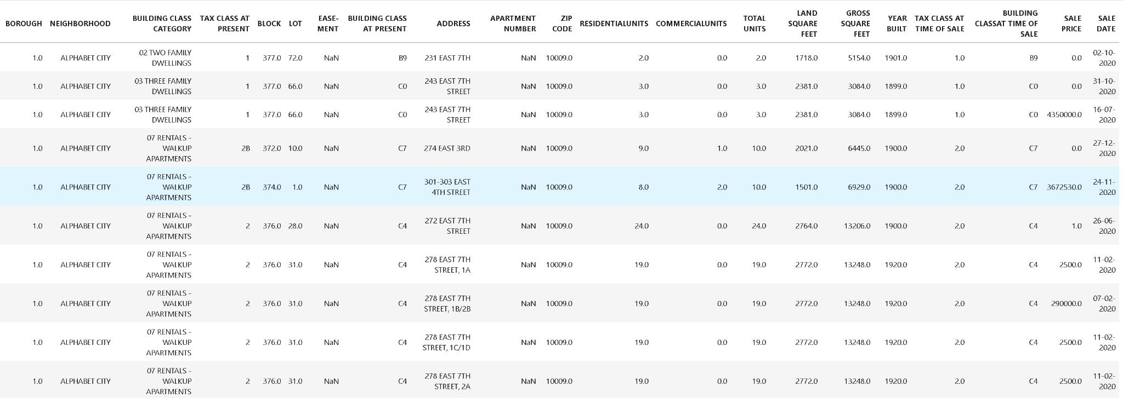
DATASET

Slide 7
ABOUT DATASET
Borough - Name of borough where property is located.
Neighborhood - Neighborhood name of the property.
Building Class Category - Defines type of the building.
Tax Class At Present - Tax class based on the use of property.
Block - Region where the property is located.
Lot - Street where the property is located
Easement - Right of an entity to make limited use of another property
Building Class at Present - Type of the building before transaction
Address - Address of the property
Apartment Number - Unit Number of apartment
Zip code - Gives the zipcode of the area where the property is located

Slide 8
ABOUT DATASET
Residential Units - Number of residential units in property.
Commercial Units - Number of commercial units in property.
Total Units - Sum of Residential and Commercial units in property.
Land Square Feet - Land Area of property in square feet.
Gross Square Feet - Area of property including land area and space within construction.
Year Built - The year in which property was built.
Tax Class At Time Of Sale - Tax code of property during transaction.
Building Class At Time Of Sale - Building code of property during transaction.
Sale Price - Target Variable . Selling Price of the property.
Sale Date - The specific time when property was sold.

Slide 9




DATA PIPELINE

Slide 10
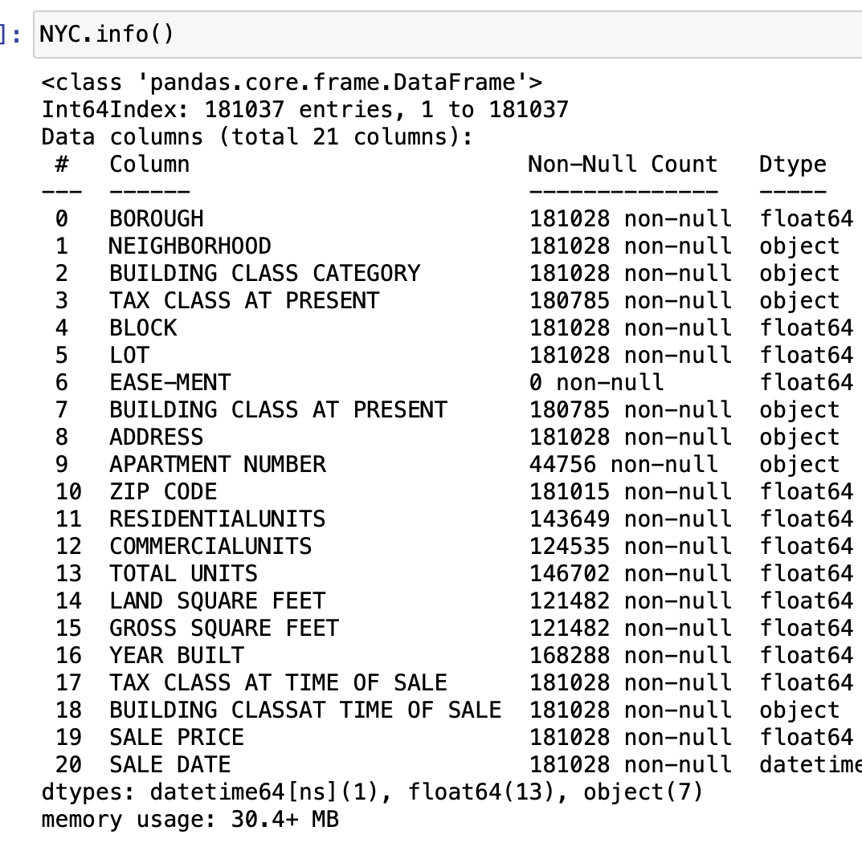
DATA UNDERSTANDING
Before doing data cleaning, some explorations and data visualizations were applied on data set. This gave some idea and guide about how to deal with missing values and extreme values. After data cleaning, data exploration was applied again in order to understand cleaned version of the data.

Slide 11
DATA PREPARATION
First step for data cleaning was to remove duplicate instances and then converting some of the columns to appropriate data types and removing unnecessary features such as ‘sale date’ , ‘easement’ and ‘apartment number’.
Removed outliers or noisy data using z-score for values which were greater than 3 or -3
Handled null values by filling it using appropriate mean or median values for each column
After we finished certain data cleaning processes, such as(drop missing values; duplicates; outliers) the cleaned data contains 85843 rows and 19 columns.

Slide 12
EXPLORATORY DATA ANALYSIS
Performing series of exploratory data analysis requires that we look at all the columns and check if certain columns would affect the prediction or not.
If some columns for example that doesn’t affect the target feature at all, we know during feature selection to remove it.
And we also need to explore missing values, if too many values are missing for a certain column, its best to remove it.
It’s also important to compare the target feature to other features in graphs to understand the metrics.
In slide 13, we can see that the graph is right skewed, ‘SALE PRICE’ as it increases there are less houses and ‘DENSITY’ meaning amount of houses are more for less price.

Slide 13
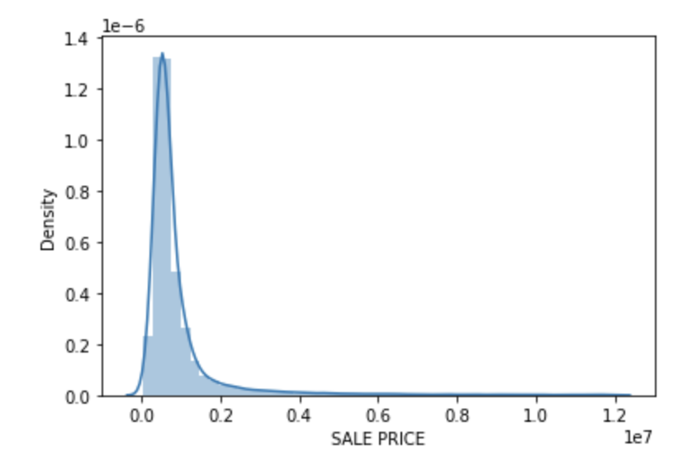
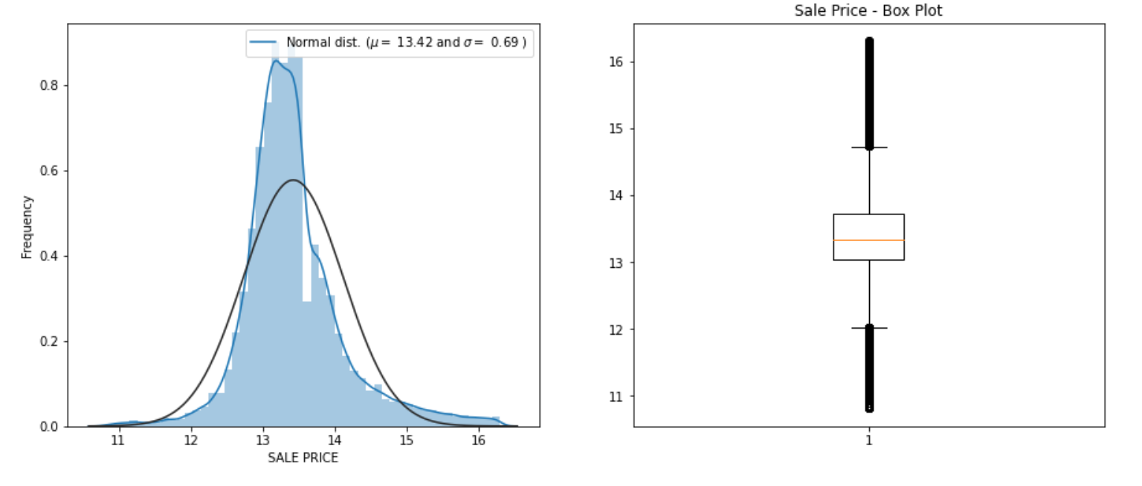
EDA: Property Sale Price (Target variable)
The target variable is the sale price of each property.
The distribution of raw data is really sparse
Many sale prices occur with a nonsensically small number: $0 most commonly (note that 40% of the sale price is $0)
We set a reasonable range: $50000 (43% rows dropped) ~ $12M (0.7% rows dropped) by removing the instances
Perform log transformation to remove skewness of data

Slide 14
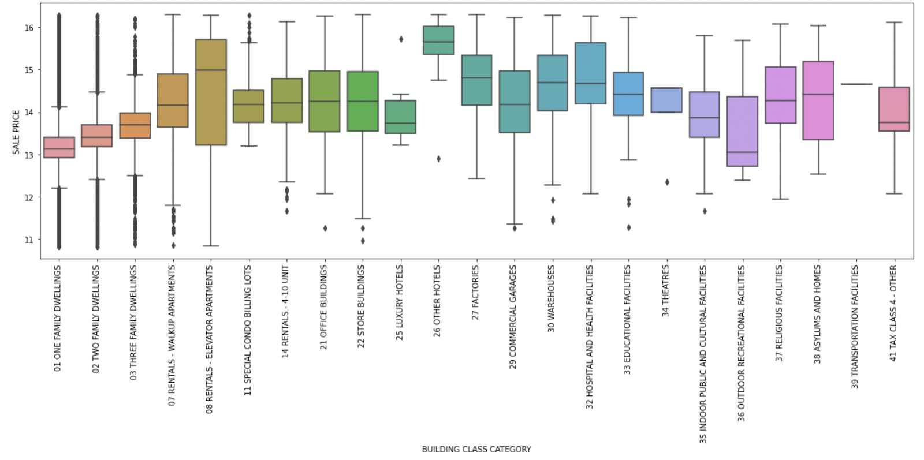
EDA Predictive Features
These graph shows us the outliers for these predictive features. This helps us determine which columns contain irregular data

Slide 15
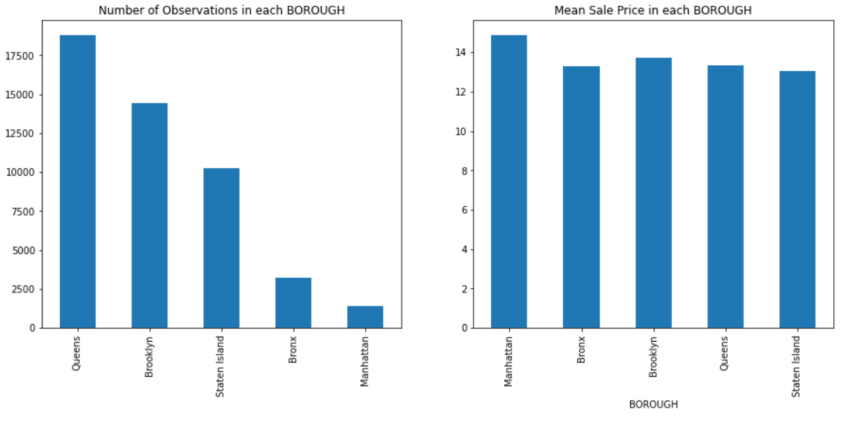
EDA: Borough
Number of Building and the mean sales price in each Borough

Slide 16
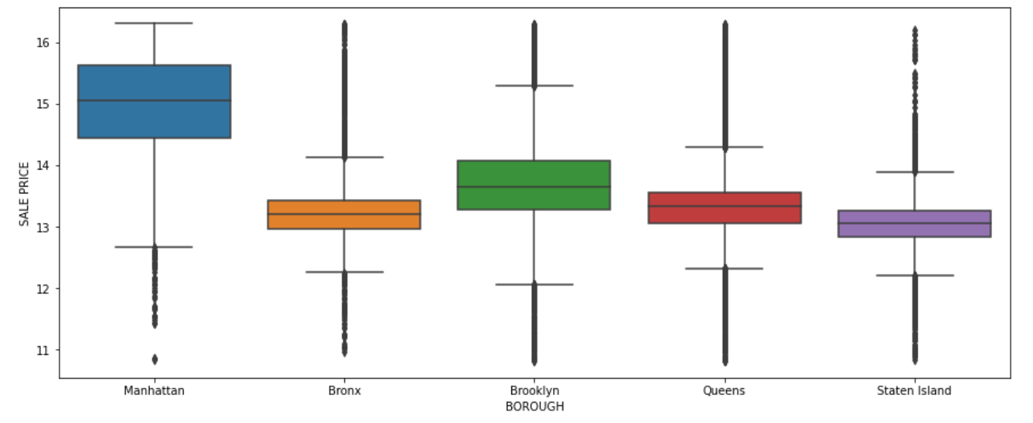
EDA : Borough Box Plots

Slide 17
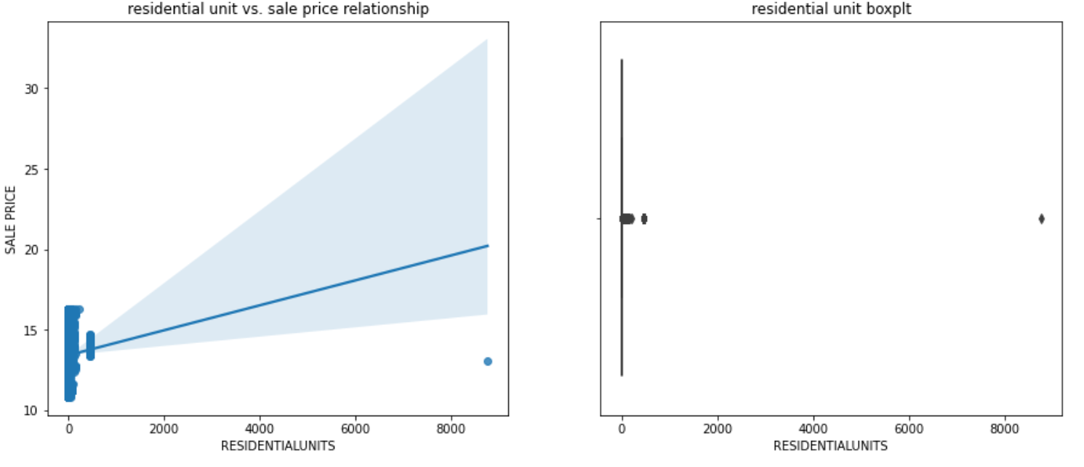
EDA: Units

Slide 18
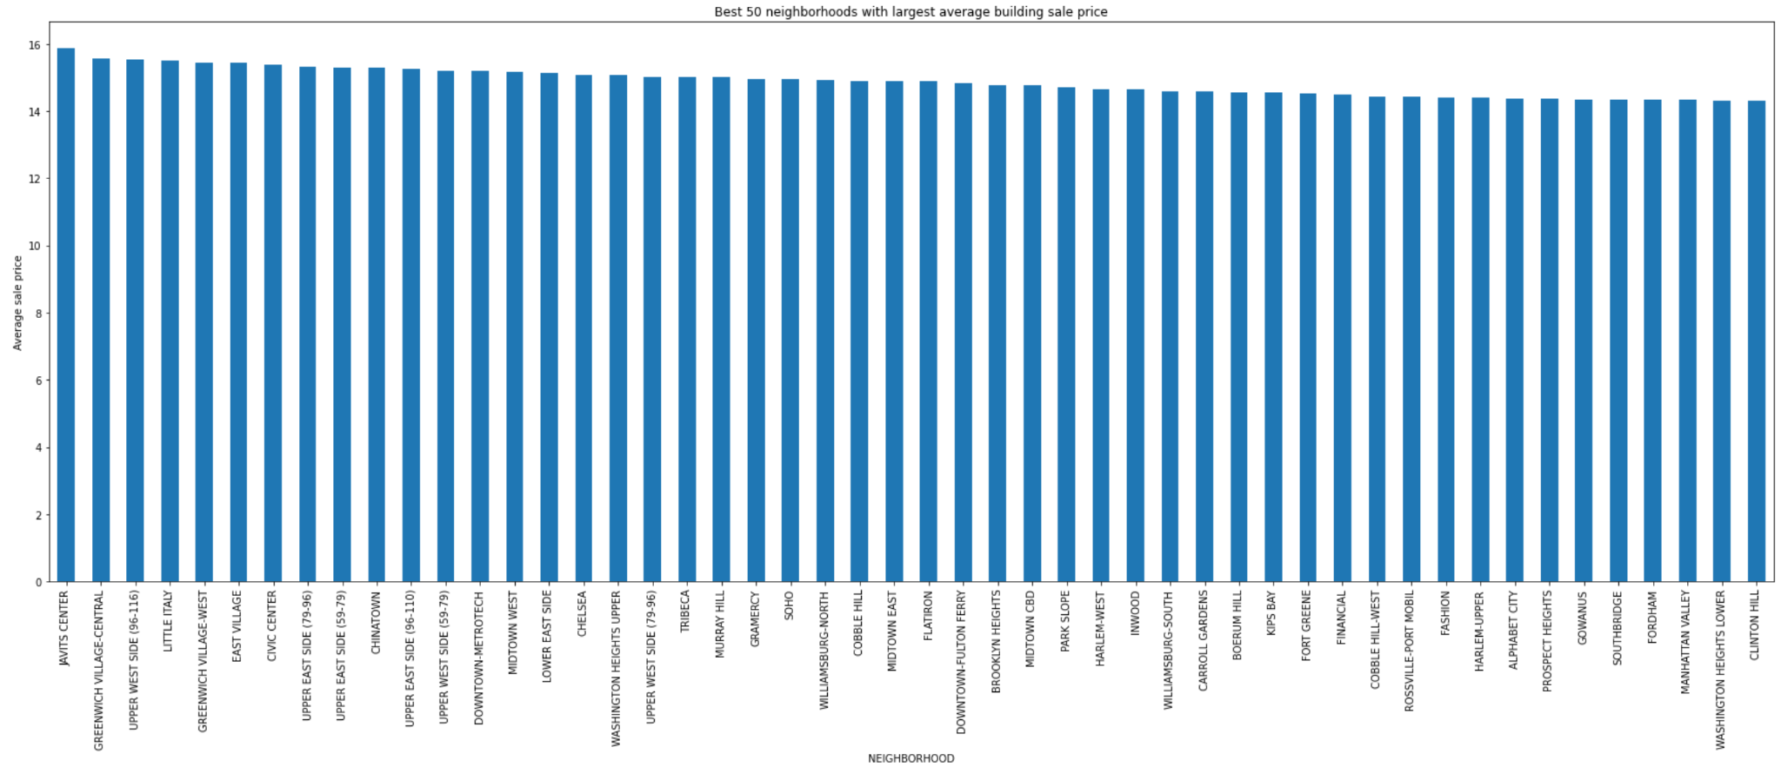
EDA : Best Neighborhoods
Best 50 Neighborhoods with largest average building sale price

Slide 19
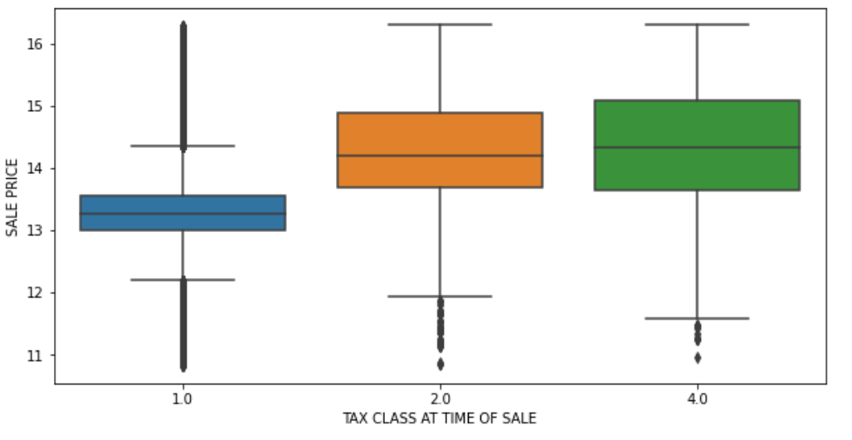
EDA : Based on Tax Class of Property
Boxplot of log(1 + Sale Price) against Tax class at time of sale
Notes:
By looking at the boxplot of our transformed sale price against Tax Class at Time of Sale, there are 3 unique tax classes at time of sale. Tax class 1 is more right skewed with more high sale price outliers; tax class 2 has fewer high sale price outliers and tax class 4 has none. Tax class 1 has a smaller Interquartile Range (IQR) with the lowest median sale price; tax class 2 has a larger IQR and a higher median sale price and tax class 4 has the largest IQR and highest median sale price.

Slide 20
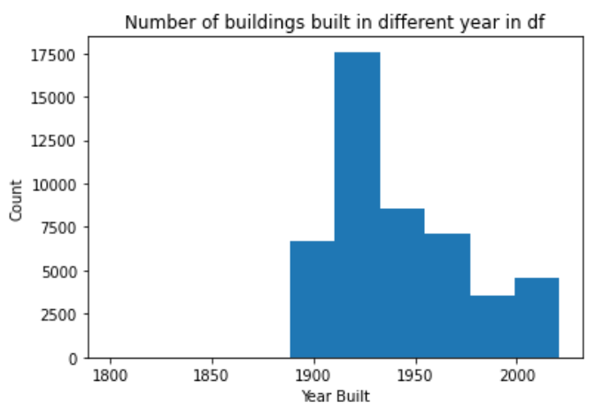
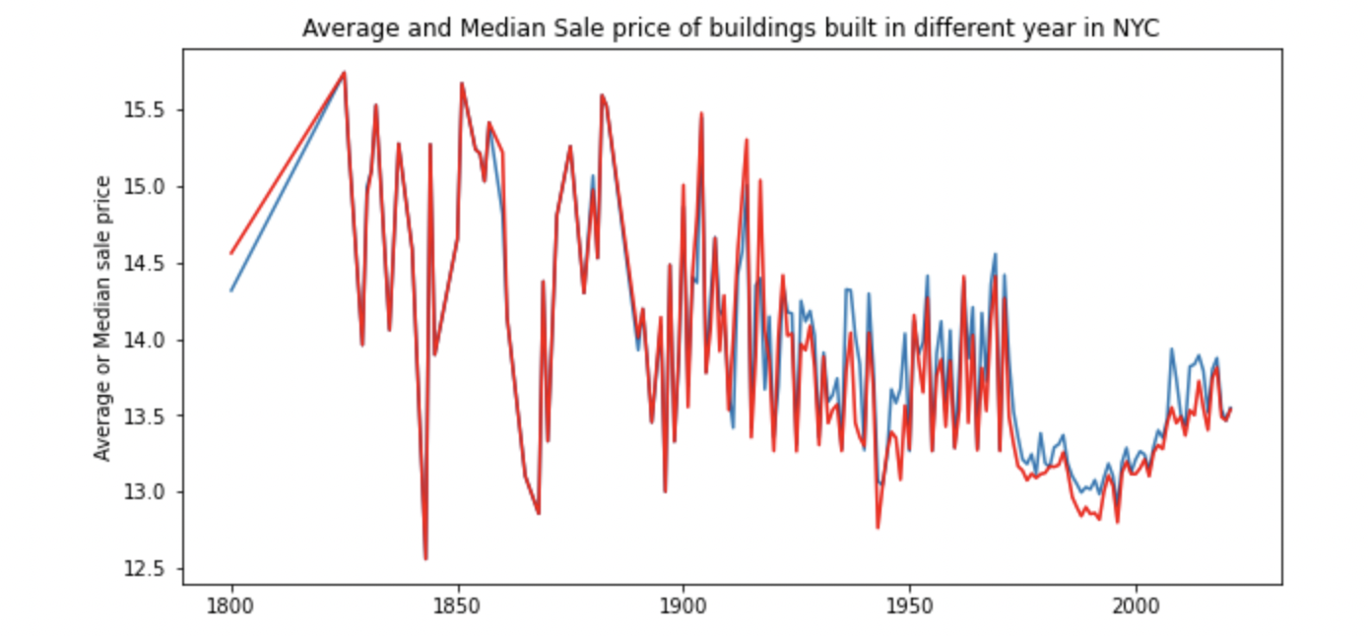
EDA : Built year of the properties

Slide 21
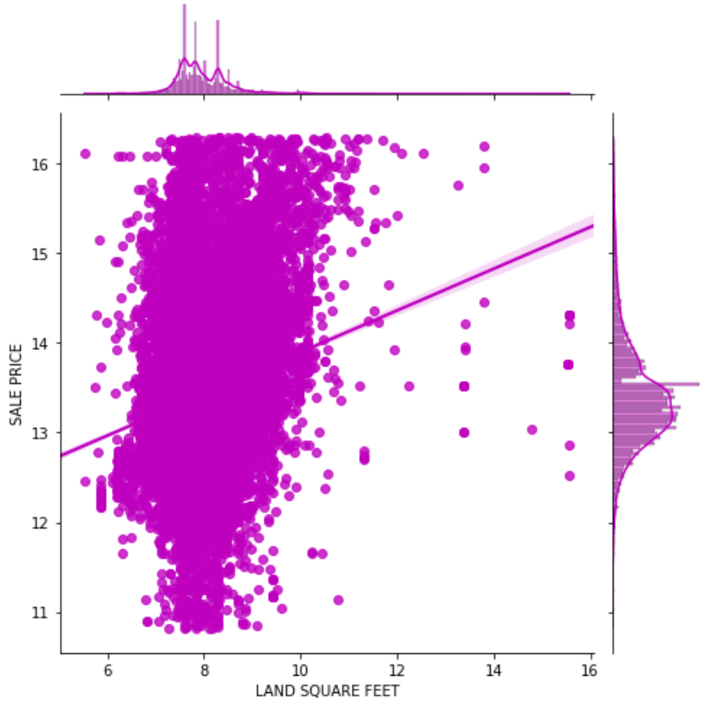
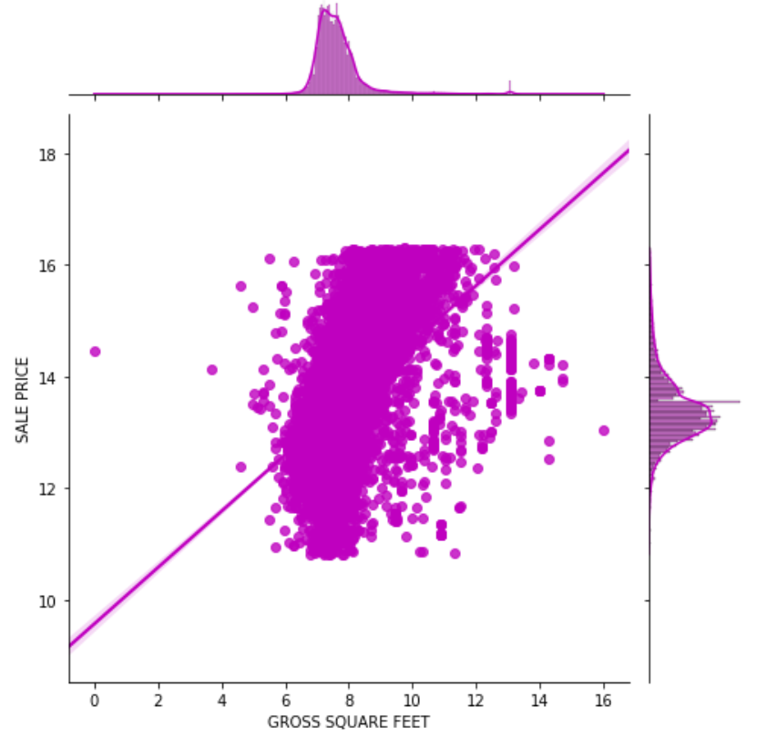
EDA: Property Area
Notes:
land square feet and gross square feet share very similar distribution. They both correlate positively with property sale price. However, we found there are cases when land square feet are small, the sale price is high. Possible explanations for such outliers might be that they lie in good geographical location or that they belong to special building classes.

Slide 22
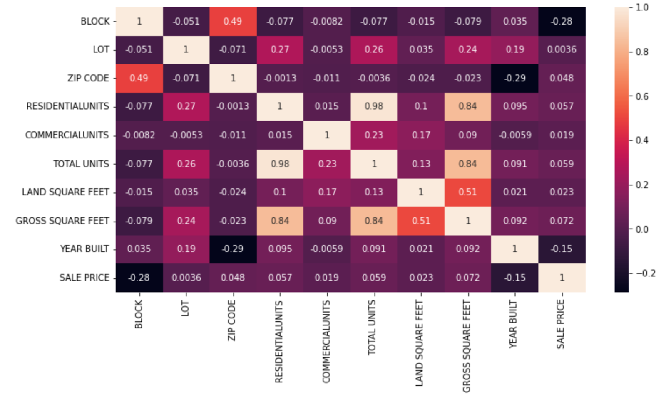
EDA: Correlational Analysis
Residential units is correlated with our target variable ​Sale Price ​positively. The same pattern exists in the ​commercial units​, the number of commercial units in a property and​ total units​ which is the sum of the former two.
Correlation between descriptive features and target variable(sales price) using Heat Map.

Slide 23
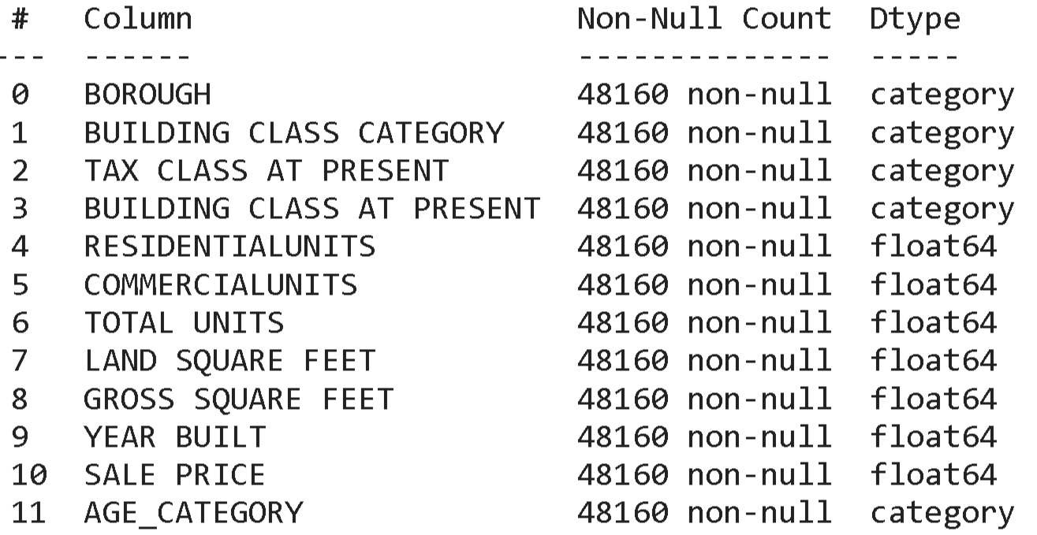
FEATURE ENGINEERING
Feature Selection
For our EDA and correlation heatmap in slide 12, we dropped columns.
Neighborhood, Address, Apartment numbers, ZIP code, Building Class at Present, Tax Class at Time of Sale, Building Class at Time of Sale, Sale Date.
Our group also dropped Easement as it only contained null values.
Feature engineering
Our scatter plot for Commercial Units vs Sale Price and Residential Units vs Sale Price, there many 0s and 1s in each plot.
So, we classified them into six groups. We used a new variable called UNIT CATEGORY which represents COMMERCIAL UNITS and RESIDENTIAL UNITS.
One HOT Encoding
We performed One hot Encoding for BOROUGH, BUILDING CLASS CATEGORY, TAX CLASS AT PRESENT and AGE CATEGORY, so the our models could read it.
Numerical feature
Land Square Feet and Gross Square Feet is skewed right on our graph based on density plots and boxplots of Sale Price,

Slide 24
EVALUATION METRICS
MSE: Mean Squared Error is the mean of the squared errors:
RMSE: Root Mean Squared Error is the square root of the mean of the squared errors:
R2 score: Is the fraction of the total sum of squares that is 'explained by' the regression.
R-squared is conveniently scaled between 0 and 1, whereas RMSE is not scaled to any particular values.
MSE is more popular than MAE, because MSE "punishes" larger errors, which tends to be useful in the real world.
RMSE is even more popular than MSE, because RMSE is interpretable in the "y" units.

Slide 25
MODEL PERFORMANCE
MODEL | MSE | R2
Linear | 0.2530 | 0.4741
Lasso | 0.3391 | 0.2952
Ridge | 0.2524 | 0.4753
Random Forest | 0.1774 | 0.6316
XGBoost | 0.1765 | 0.6331

Slide 26
THANK YOU

